Slide 1
Drowsiness Detection
Advanced Mobile Computing Class
Team 5: Do Il Yoon, Hyun Seok Oh, Hyunik Kim, Phil Goo Kang

Slide 2
Table of Contents
System Overview
Detailed Implementation
Evaluation
Demonstration
Limitation & Future Works

Slide 3





System Architecture Overview
User Interface Preview
Current Hour
SVM
Front
Camera
Eye Blinking Detector
Accelerometer Sensor
Accelerometer feature extractor
Time-series Feature Concatenator
CNN
GPS
Micro-phone
Speech Recognizer
Ensemble
After-detection (Peer Calling)
Foreground Thread
Background Thread

Slide 4
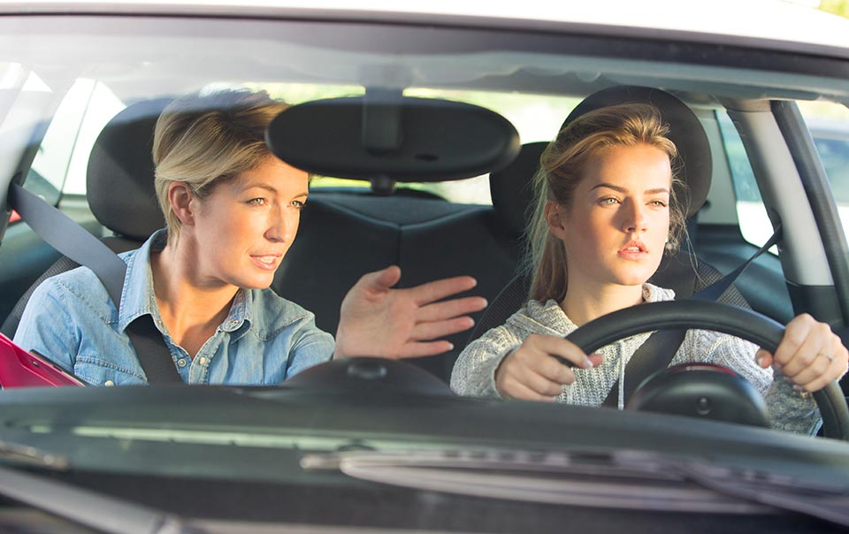
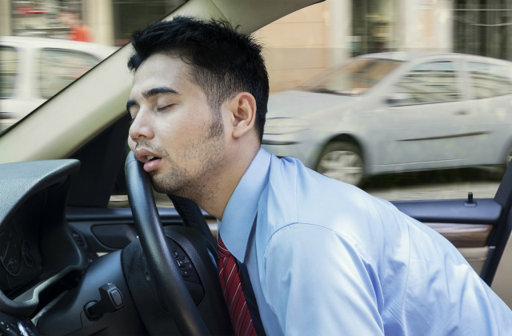
Eye Detection Module
Human vision is a critical factor in driving

Slide 5

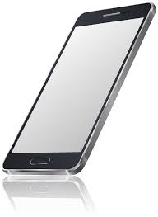
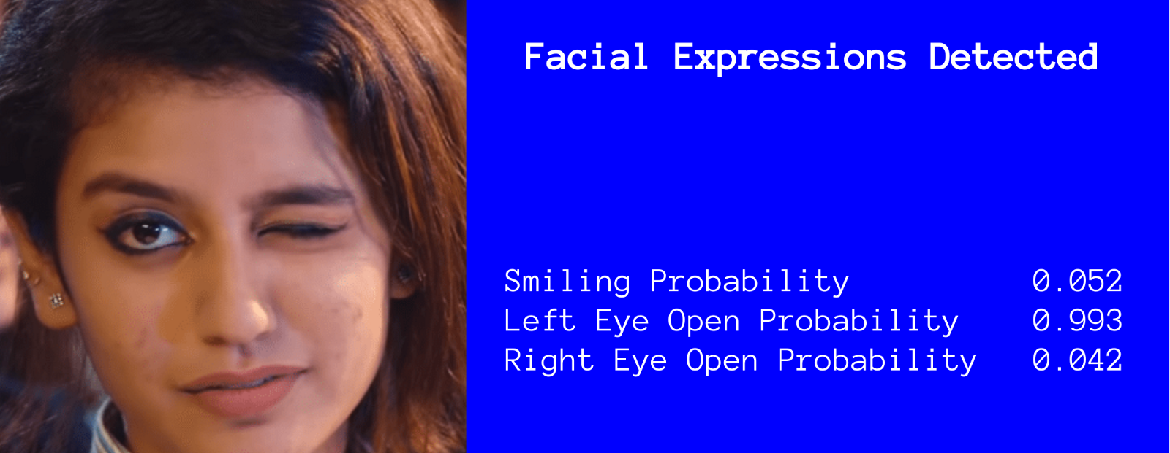
Eye Detection Module
Drowsy
Left or Right below
threshold?
Capture Image
Tracker
<Face>
Normal
Sampling: 30 fps

Slide 6
Speech Recognizer Module
NO_MATCH
SPEECH_TIMEOUT
Result (0)
startRecording
continue = true
onResult
confidence > 0.5
Idle
Listening
Result (1)
continue == true
fireSRIntent
stopRecording
continue = false

Slide 7
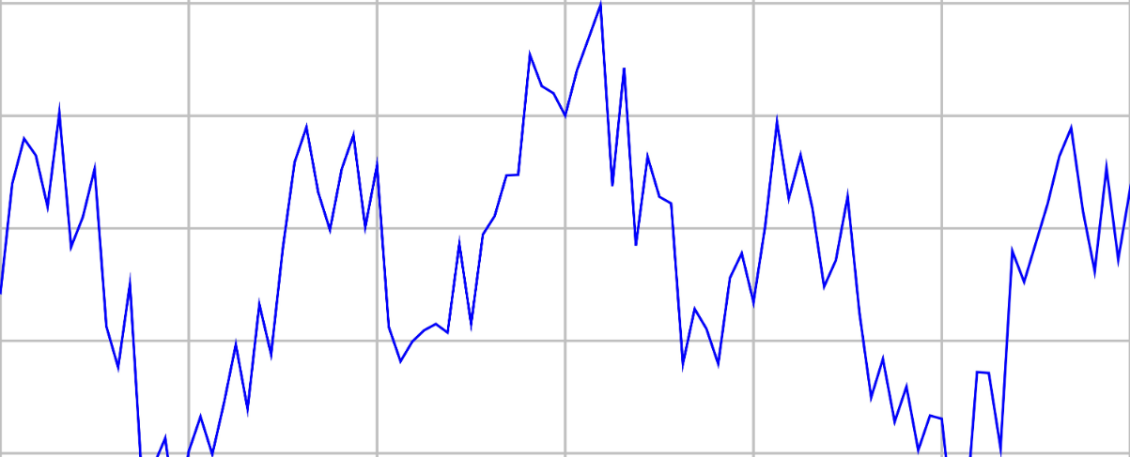
Time-series Feature Concatenator
Time Window
Accelerometer
Concatenate features extracted from each module through time-series
Eyes Closed
Speaking
Location
Time

Slide 8
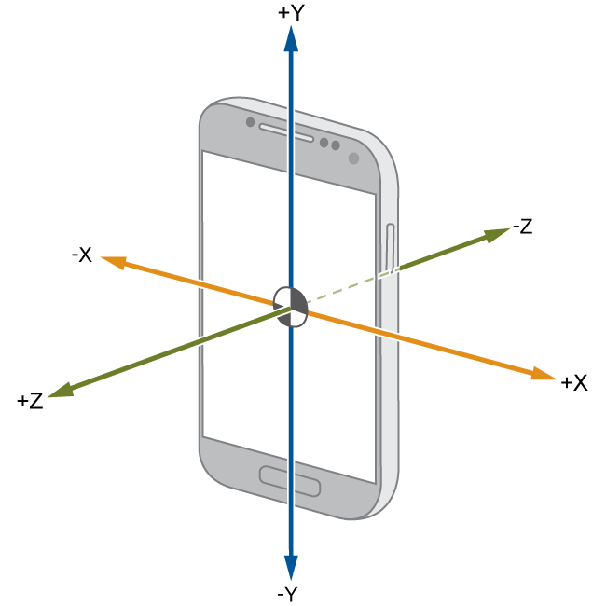
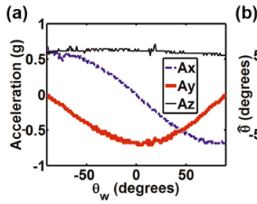
Accelerometer Module [1/2]
Phone is faced upright towards user
Use x-axis & z-axis to monitor movement
Throw away y-axis data
Accelerometer detects movement of device
Record the changes in x-axis & z-axis to detect anomaly in driving

Slide 9
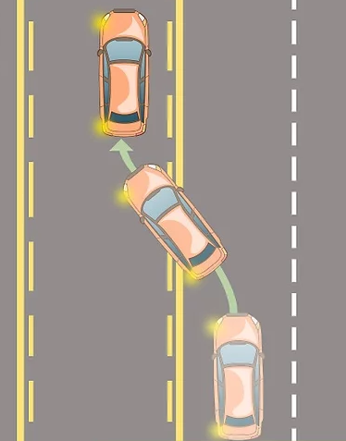
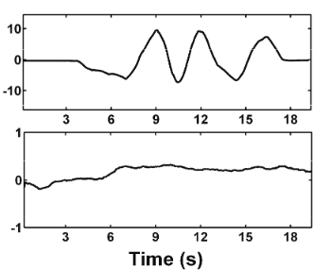
Accelerometer Module [2/2]
Drowsy sharp changes
When driving, if your not drowsy, changes in acceleration is smooth
If your drowsy, sharp changes (large abnormality) in driving is detect
Smooth driving because you're awake

Slide 10
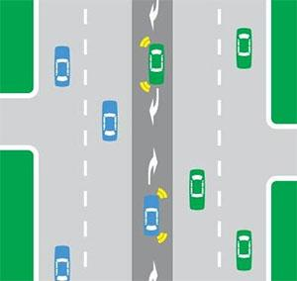
GPS Location Module
Original plan
Use GPS location data to detect driving pattern & location
Using these dataset detect drowsy driving
Issue:
Google Road API does not offer this feature for korea roads
Naver does not offer such API either
Unable to develop this feature

Slide 11
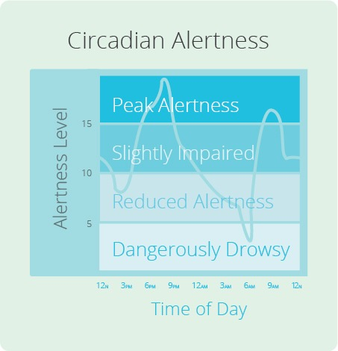
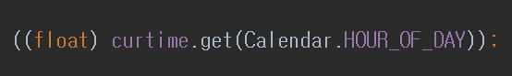
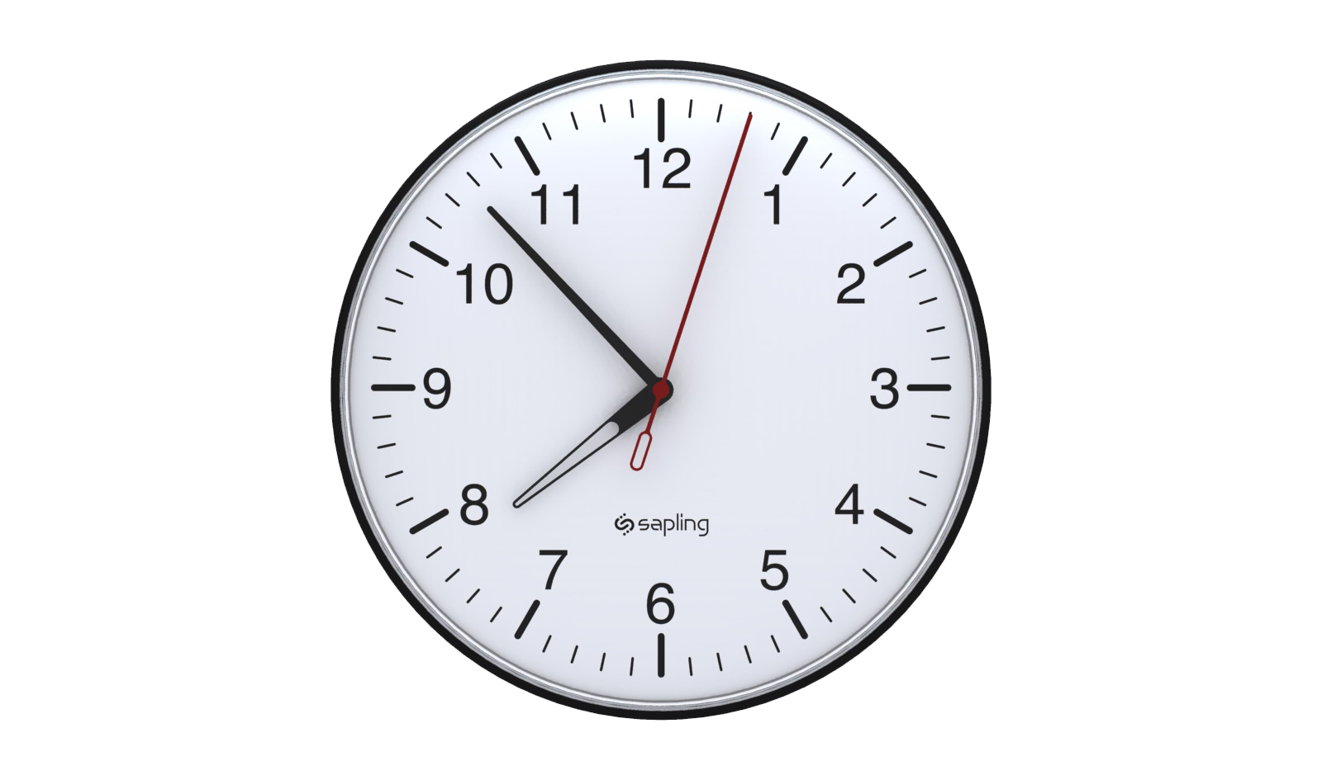
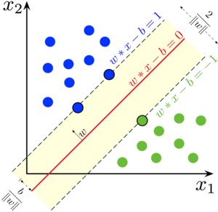
SVM Drowsiness Classifier
Android Libsvm was used for SVM library
Radial basis function for kernel
Current hour is also used as a feature
Ensembled with CNN with equal probability 0.5
Feature
Drowsy / Awake
Vectorize
SVM
Detect
Time

Slide 12
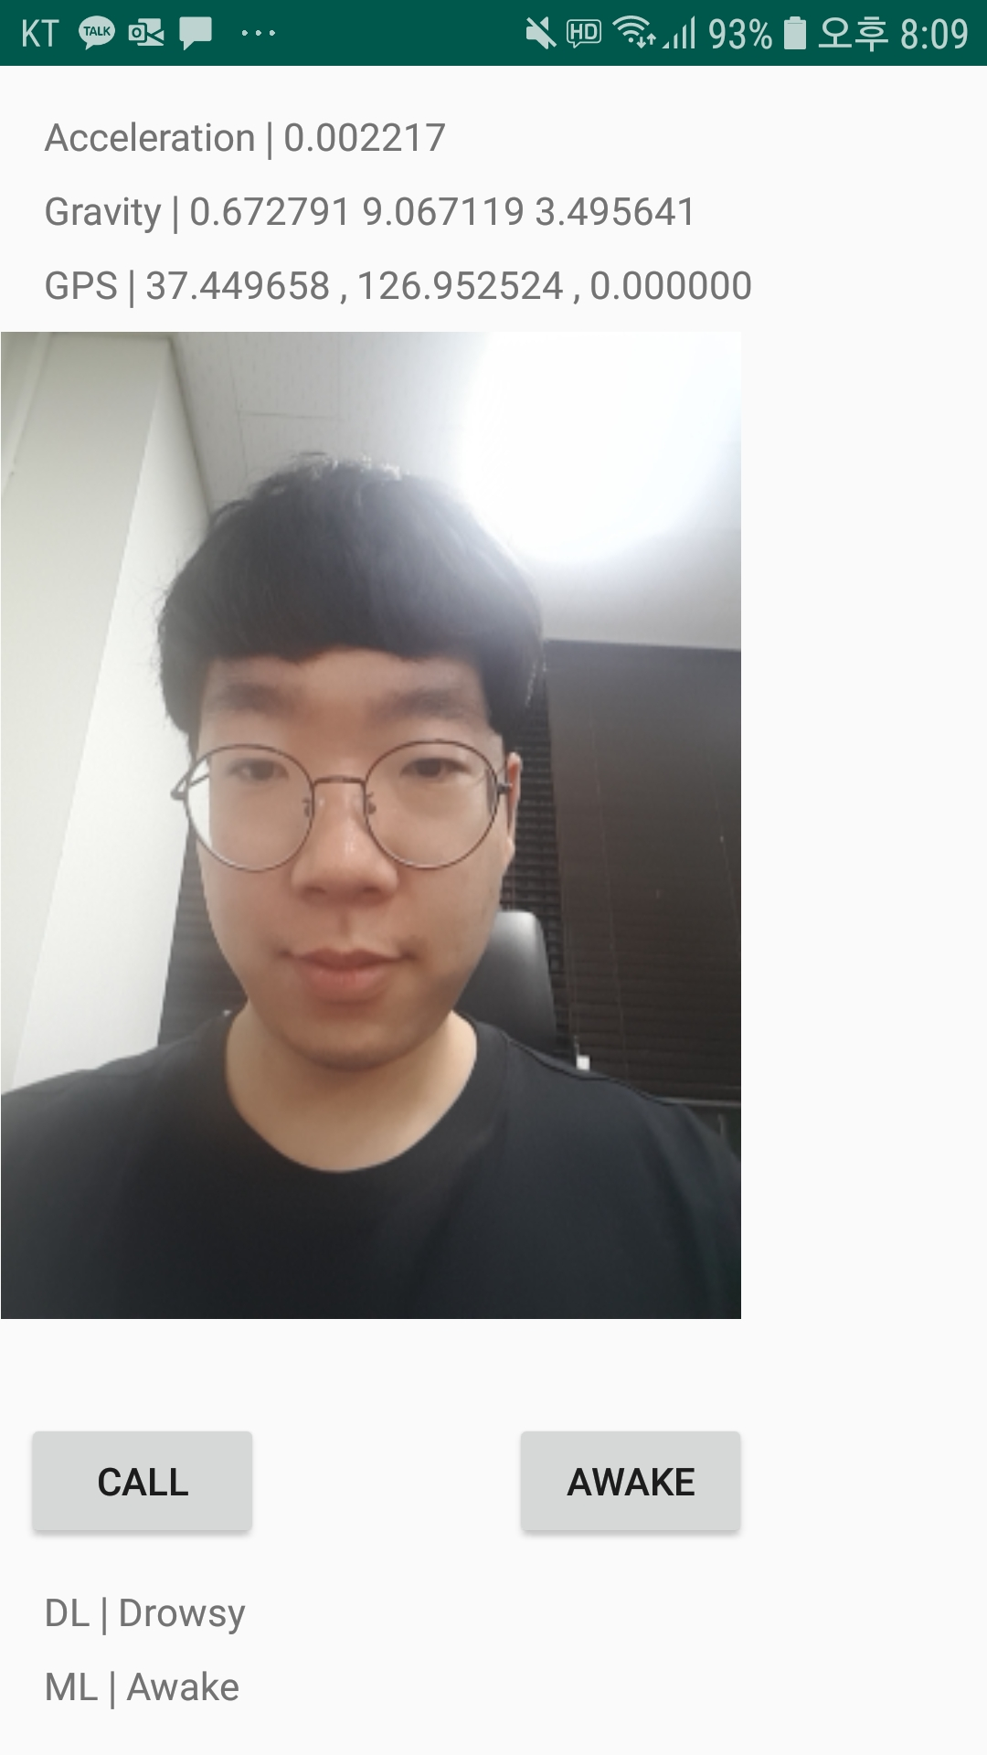
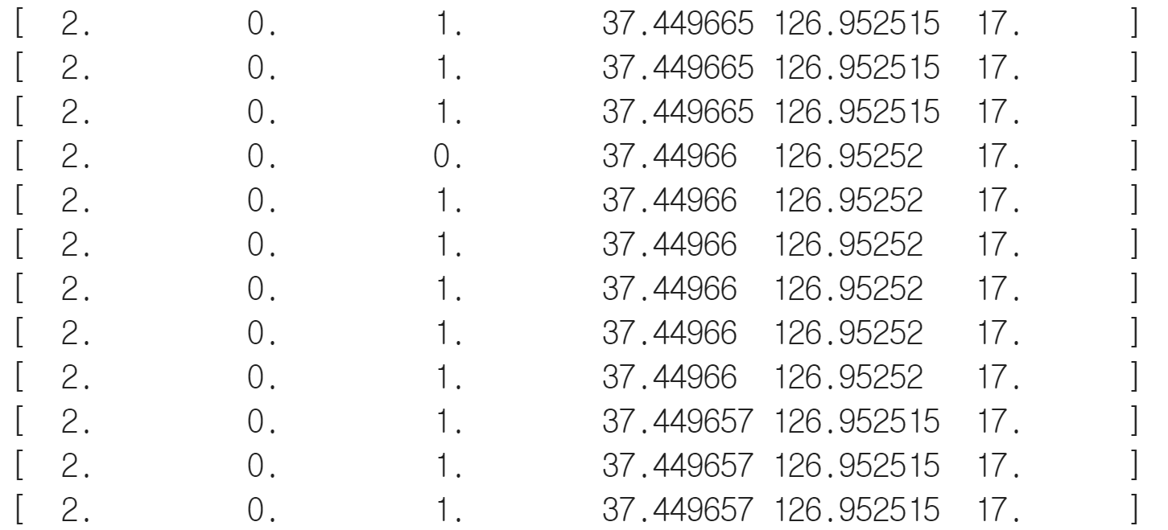
Convolutional Neural Network Drowsiness Classifier
Tensorflow lite to use Keras DNN model in mobile
CNN on time window sensor data
RNN / LSTM was impossible to apply TFlite
1-dimensional convolution
Ensemble with SVM
Output
Input
FC1
FC2
Max Pool
Conv1

Slide 13
Data collection
Drowsy driving
Cannot create controlled drowsy driving situation
Simulation
Not readily available
Not accurate enough
Mimic drowsy / awake driving situation
Awake: occasional blinking + ongoing conversation
Drowsy: prolonged eye closure + no conversation

Slide 14
Result
Online inference shown with demonstration
Intermediate ML result
Final DL result

Slide 15
Limitations and Future Works
Not able to obtain actual drowsy driving data
Too dangerous
Did not connect drowsiness detection result and peer calling
Detection unstable due to insufficient training data
Non-optimal sampling rate for each feature
No validation for feature selection
Did not get to validate our intuition behind selecting each feature
Background service would have been better
Cannot use other apps when it is foreground
Android limits background work, future works to overcome it

